Slide 1
Chief Executive’s update
Board of Directors
27 January 2021

Slide 2
Current situation
384
cases per 100,000 population in Wigan, 6-12 Jan 2021
3rd highest in Greater Manchester
Challenged
bed/staffing position, both critical care as well as general and acute beds
547 unplanned staff absences (8% of total workforce)
100 more nurses in work compared with November 2020 due to reduced numbers of unplanned absences
Notes:
COVID-19 cases
Most recent data 2 to 8 January 2021
Highest – Manchester
2nd – Rochdale
3rd – Wigan

Slide 3
So what does this mean?
Currently tracking above the worst-case scenario
Surge plan activated, now operating on regional basis
Mutual aid arrangements in place for Greater Manchester and Liverpool
Critical care and CPAP capacity being closely monitored

Slide 4
So what does this mean?
Redeployment of staff using risk-based and skills-based approach
Focus on psychological and wellbeing support for staff
Elective programme restricted whilst maintaining life, limb and sight-saving procedures
Visiting restrictions in line with national policy

Slide 5
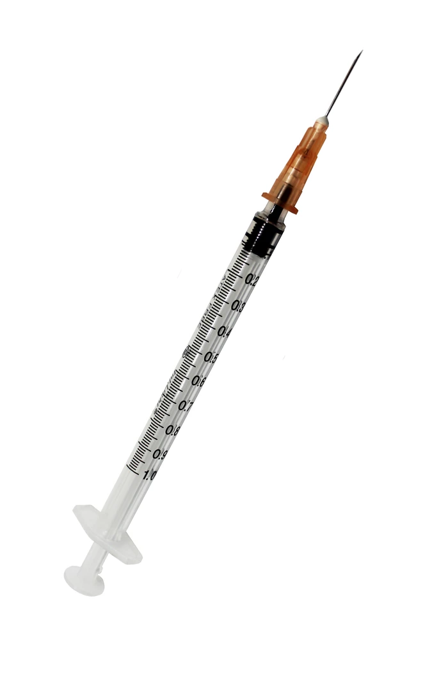
Vaccination programme
Pfizer-BioNTech vaccine
7,000 vaccines administered (as at 22 Jan 2021) – 5,500 to WWL staff and the remainder to other priority groups such as primary and social care staff
100% of WWL staff have been offered a vaccination
12 weeks between first and second dose in line with strict government guidance

Slide 6
Additional vaccinations
As a hospital hub, we have been asked to extend the scope of our vaccination programme to cover c.6,000 additional people:
frontline social care staff from across the borough
frontline primary care staff
We are prioritising reablement services, frontline social care and home care
Patients are currently being vaccinated by Primary Care Networks (PCNs), but we are looking at how we can support priority patients

Slide 7
5 priorities for the NHS in the North West
Creating immediate capacity through safe discharge
Maximise the pace of roll-out and delivery of the COVID vaccination programme
Ensure rigour and professionalism of infection prevention and control processes across all settings
Participate fully in system Gold mechanisms to support each other, increase critical care surge capacity and protect urgent non-COVID work as long as we can
Support staff through strong communication and providing health and wellbeing and pastoral support

Slide 8
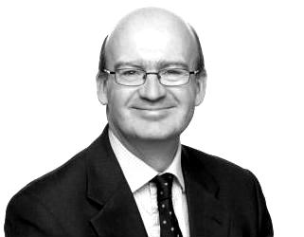
Approach to meetings
“
As Chairs I will be looking for your leadership in supporting your executive teams and staff at a hugely challenging time; enabling them to focus on these important priorities by minimising unrelated activity (for example postponing all Board development or strategy sessions, keeping Board meetings and committee meetings to the minimum needed to give effective assurance on these priorities)…and giving your backing to the redeployment of clinical staff to the opening of frontline capacity or to accelerate the vaccination programme wherever possible.
Bill McCarthy
Executive Regional Director (North West)
NHS England and NHS Improvement

Slide 9
Financial considerations: a year of two halves
H1 2020/21
H2 2020/21
IN
OUT
IN
OUT
All COVID expenditure matched each month, so break-even position throughout
COVID expenditure ‘pot’ provided at system level. For WWL, this means a c.£3m difference each month

Slide 10
What have we done?
We have written to NHS England and NHS Improvement to outline our concerns as we are required to do
We have arranged a meeting with the Regional Finance Director to raise our concerns in person
We are continuing to provide high quality care for our patients
We are continuing to authorise COVID expenditure and will continue to closely monitor this situation through the Finance and Performance Committee and the Board of Directors

Slide 11
Other updates
Nationally, safe staff reporting to board has been paused
We have applied to DWP for 30 x 6-month kick start placements for those who are unemployed between ages of 16-24 year-olds to work in COVID support roles, e.g. vaccination programme, mask fit testing, ward support
Temporary registers have reopened for international recruits and domestic students in the last 12 weeks of their undergraduate nursing course
We are working with partner organisations in a place-based way and we are well-connected with specialist long COVID clinical pathways
Notes:
The kick start roles are funded by DWP if we are successful, and the young people are paid at national minimum wage.

Slide 12
Key messages
REMEMBER ‘WWL’:
W
ash hands
Our hospitals are busy but we have robust plans in place and we remain open for all who need us
Advice is available from GPs, by dialing 111 or at 111.nhs.uk
W
ear a mask
L
eave a distance

Slide 13
Any questions?

